Slide 1
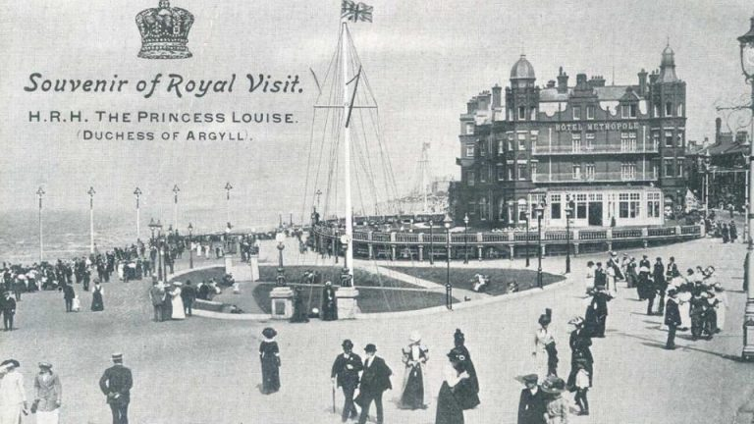
Blackpool in the past
Please use this powerpoint to help support your teaching for Week 2 home learning.

Slide 2
Watch the video link of Blackpool Prom 1900
https://youtu.be/ctSWBvyzSIs
Ask your child/children these questions:
What can they see?
Do they recognise any building in the video?
Do the people look the same or different to them?
How are they travelling around the prom?
How is the video different to modern videos?

Slide 3
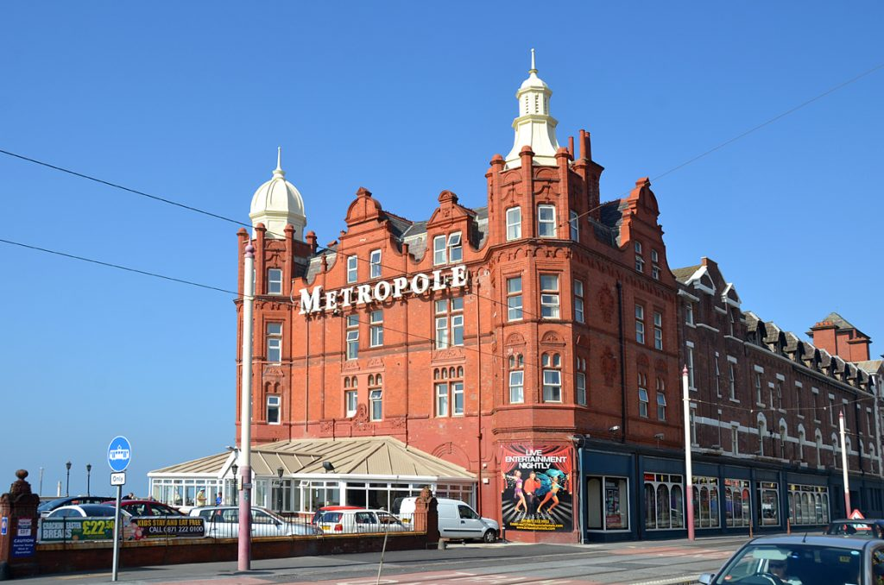
Look at these two photographs of the Metropole- how are they the same/different?

Slide 4
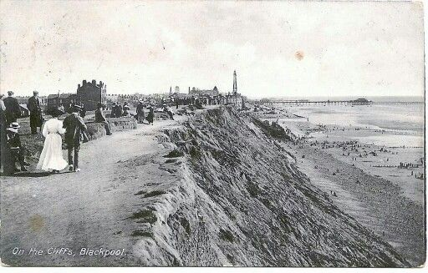
What do you notice in this picture?

Slide 5
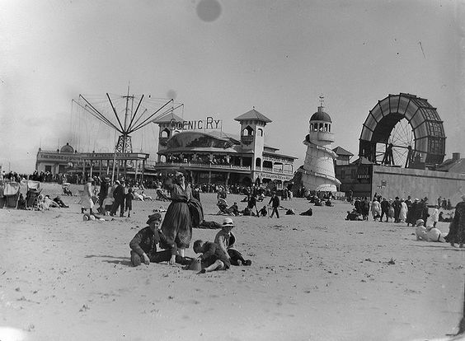
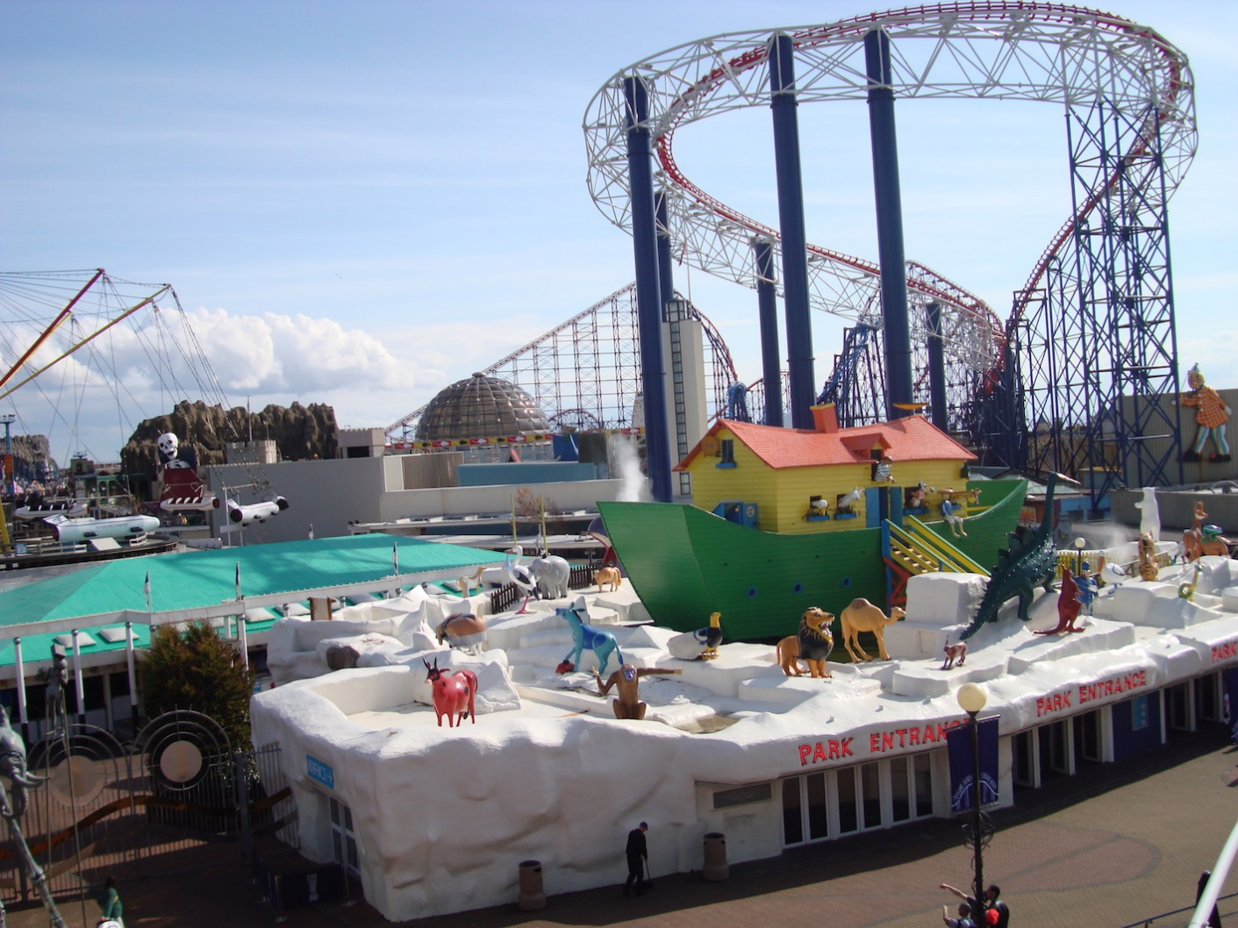
This is Blackpool Pleasure Beach then and now. Has it changed?

Slide 6
Then and now
Now go back and revisit some of the pictures and the video. See if you spot these different points.
Did you notice the lamp lights? They aren’t like ours. They had to be lit every night. They did not use electricity.
What are people wearing? Clothes and fashion have changed a lot over time. You can see most of the ladies are wearing full dresses and hats and the men are wearing suits. How is that different to what we wear today?
Did you notice the older photos are in black and white? Colour in photographs only became popular in the 1960s.

